Slide 1
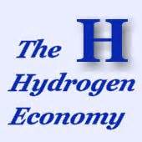

Unit 1

Slide 2
Text I Fuel Cell -- understanding
Opening section – Introduction (Para.1-3)
Scan through the 3 paragraphs and answer the following questions briefly.
What is President Bush's speech about?
How did President Bush think of fuel cell and fuel cell powered automobiles?
Why do you think the author quote the present’s State of the Union Address ?
What is the function of Para. 3?

Slide 3
Text I Fuel Cell -- understanding
The Gas Battery
(Para. 4-6)
Identify the time expressions and draw a timeline to
trace the history of battery technology
In 1800,…
In the 1820s,…
By the early 1830s …
In 1839…
Well before the end of the decade…
By 1859,…
In 1873,…
By 1882, …
At the end of the 19th century, …
In 1900, …
In 1906-1909, …
By 1912, …
In 1921, …
Task 3

Slide 4
Text I Fuel Cell -- understanding
The Gas Battery (Para. 4-6)
What were some advantages of electric cars over the gasoline-engine cars at the end of 19th century?
What were the reasons for the later popularity of gasoline-powered vehicles?

Slide 5
Text I Fuel Cell -- understanding
Electric car resurgence (Para. 7-15)
How did electric car come back to stage?
Where was fuel cell applied?
What are different kinds of fuel cells in terms of electrolyte?
What happened to Ballard’s bus when it had its public roll-out in 1993?

Slide 6
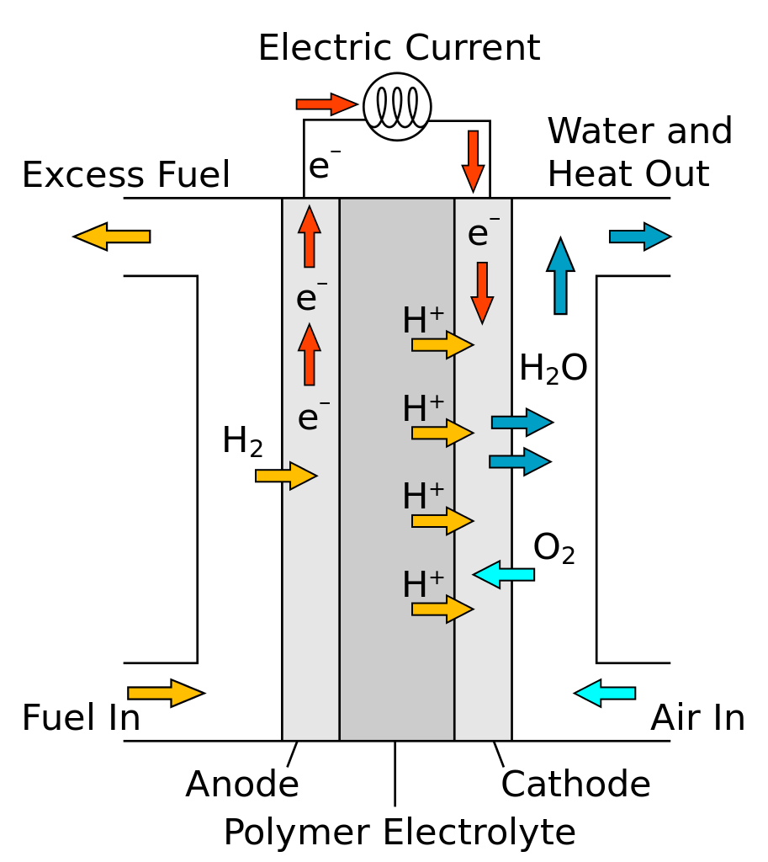

Text I Fuel Cell -- understanding
Electric car resurgence (Para. 7-15)
Could you describe how the proton-exchange membrane (PEM) fuel cell works? (Task 8)

Slide 7
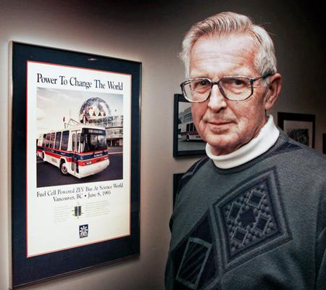
Text I Fuel Cell -- understanding
Electric car resurgence (Para. 7-15)
What was his answer to the energy problem? What efforts did he made to develop new power system?
Read through Para10-14, and recount the story of Ballard.
Geoffrey Ballard (1932-2008)

Slide 8
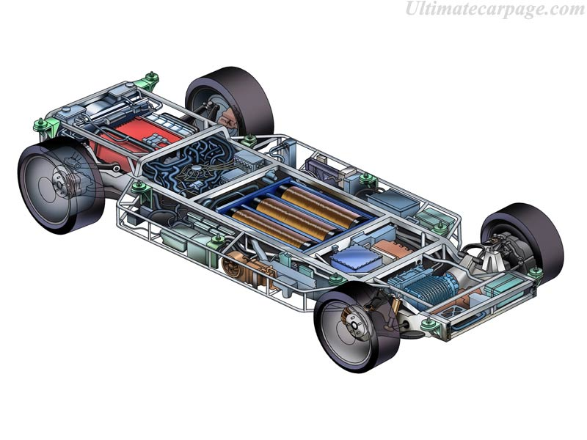
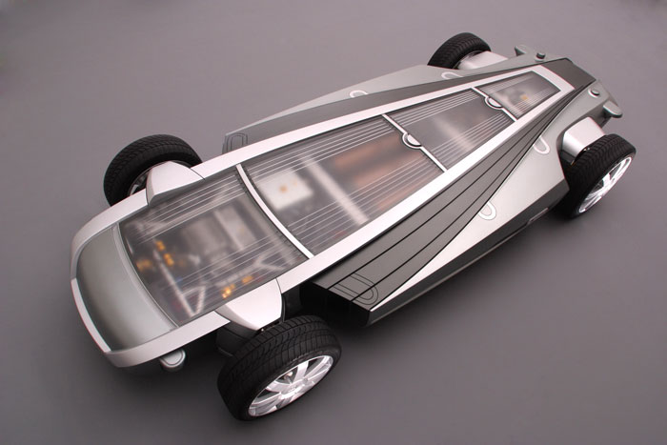
Text I Fuel Cell -- understanding
Into the main stream (Para. 16-18)
What are the features of the General Motors’ concept car termed Hy-Wire? Why is it also referred to as the China car?
What are some favorable aspects of fuel-cell powered vehicles ?

Slide 9

Text I Fuel Cell -- understanding
Out of the laboratory, someday (Para. 19-22)
Read through this section and summarize the practical problems to be solved.
What does Catch-22 mean in the text?

Slide 10
Text I Fuel Cell -- understanding
Fuel-cell phone (Para. 23-27)
In what industries or areas are fuel cells likely to be used? What is the author’s prediction?
What other applications of fuel cell are mentioned?
What is the prospect of fuel cell technology according to the author? What makes him think so?

Slide 11
Text I Fuel Cell
Think about:
The purpose of the article;
The rhetorical strategies used to achieve the purpose;
The way of organizing the information.

Slide 12
Text 1 Fuel Cell
The purpose of the article:
to convey the information about the history, status and future of fuel cell
Way of organizing information: chronological order
The rhetorical strategies used:
quotation
definition
historical account (narration)
description
evaluation,
explanation
exemplification
prediction

